Slide 1



CROP AND FERTILIZER RECOMMENDATION SYSTEM USING MACHINE LEARNING

Slide 2

Learning Objectives :
Understanding machine learning in crop and fertilizer (agriculture) field.
Data Collection and Preprocessing - cleaning and preparing for analysis.
Model Selection & Training - Exploring decision tree classifier model and making prediction .
Performance Evaluation - Assessing model accuracy.
Feature Impact Analysis - Understanding how soil and environmental factors affect recommendations.
GOAL

Slide 3
Tools and Technology used :
Programming language – Python
Jupyter Notebook – Development environment
Machine learning model – Decision Tree Classifier
Libraries and packages :
Pandas – Data manipulation and preprocessing
Numpy – For numerical operations
Scikit learning – For machine learning algorithm ,training & evaluation
Matplotlib & Seaborn – For data visualization and analysis
Dataset – dataset with soil parameters like Ph, Nitrogen, Phosphorus, potassium and weather conditions.
Performance Metrics - Accuracy

Slide 4
Methodology :
Developed an ML-based system for crop and fertilizer recommendations.
Data Collection & Preprocessing
Packages Used: pandas, numpy
Methods: Data cleaning, handling missing values, feature selection, and normalization
Exploratory Data Analysis (EDA)
Packages Used: matplotlib, seaborn
Methods: Data visualization (histograms, scatter plots), correlation analysis
Model Selection & Training
Packages Used: scikit-learn
Methods: DecisionTreeClassifier for training, train_test_split() for data splitting
Model Evaluation & Optimization
Packages Used: scikit-learn
Methods: accuracy_score(), classification_report()
Final Testing & Validation
Packages Used: scikit-learn, pandas
Methods: Testing with different values, evaluating generalization performance

Slide 5
Problem Statement:
Farmers face challenges in selecting suitable crops and fertilizers due to variations in soil nutrients , pH levels and environmental factors like temperature , humidity ,and rainfall .traditional farming methods rely on experience which may lead to inefficiencies , lower yields and soil degradation . There is a need for a data driven approach to make accurate agricultural recommendations and decisions.

Slide 6
Solution:
To address this issue , we have developed a crop and fertilizer recommendation system using machine learning . The system analyzes key soil parameters like N ,P , K , Ph ,temperature , humidity and rainfall to provide precise recommendations . Using Decision Tree Classifier , the model predicts the most suitable crop and the optimal fertilizer required for the better yield . The data driven approach helps farmers make informed decisions , improving productivity and soil health.

Slide 7
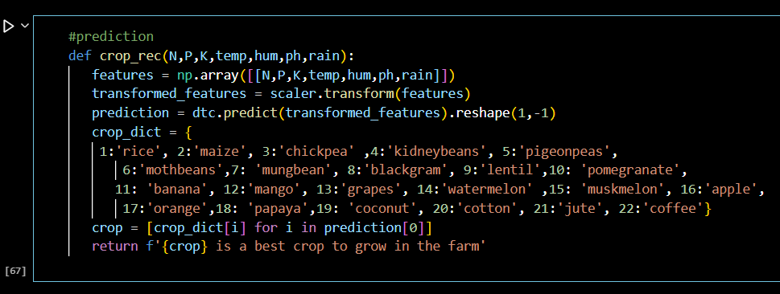
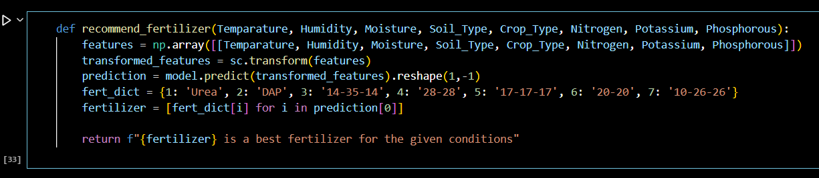
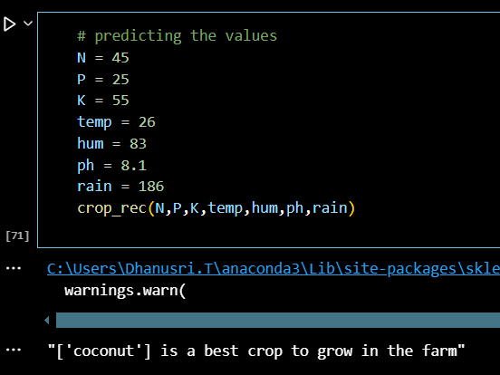
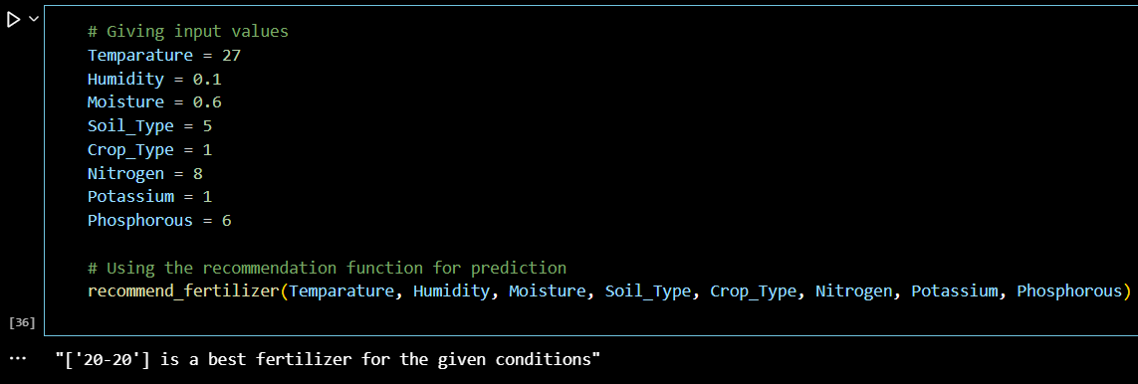
Screenshot of Output:

Slide 8
Conclusion:
The crop and fertilizer recommendation system using machine learning effectively provides accurate recommendations based on the soil nutrients and environmental factors . By leveraging the Decision Tree Classifier, the system enhances decision making for farmers , improving crop yield and resource effieciency . Thus this project demonstrates the potential of AI / ML in agriculture , promoting sustainable and data driven farming practices.

